Slide 1


WellBot
Global Wellness Assistant
Milestone 2: Chatbot Testing & Validation
Name: M ABIRAMI
Role: Testing & Validation

Slide 2






My Contribution
Core Testing Responsibilities for Milestone 2
Frontend–Backend Integration
Tested seamless data flow between the user interface and server.
Gemini API Verification
Verified response generation for accuracy, relevance, and medical appropriateness.
Medical Query Validation
Validated chatbot accuracy by comparing outputs against health guidelines.
Error Handling & Edge Cases
Checked network timeouts, empty inputs, and ambiguous user requests.
System Performance
Ensured stable performance under simulated load for a responsive experience.

Slide 3


Testing Process
Methodology & Test Case Execution
Sent sample medical and health-related queries
Monitored API request and response flow
Checked empty input and long message handling
Tested random and invalid inputs
Observed response time and system stability

Slide 4



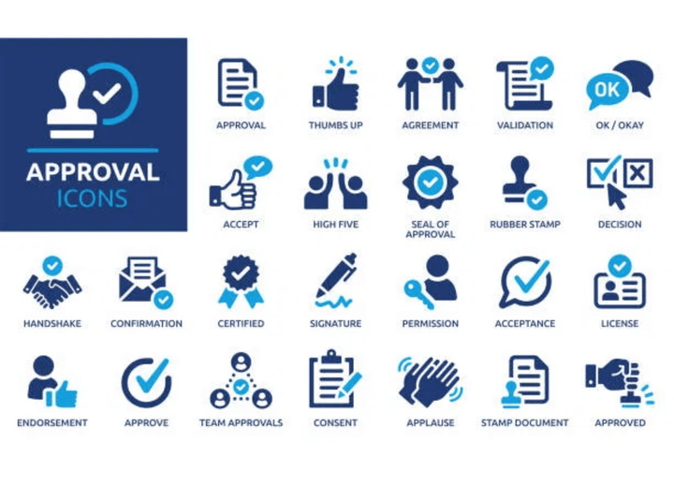


Results & Validation
Final Outcome and System Readiness
Frontend and backend communication successful
Gemini API integrated correctly
Real-time AI responses generated without errors
Edge cases handled effectively
Chatbot system performance validated
“System successfully validated for real-time AI chatbot interaction.”

